Slide 1
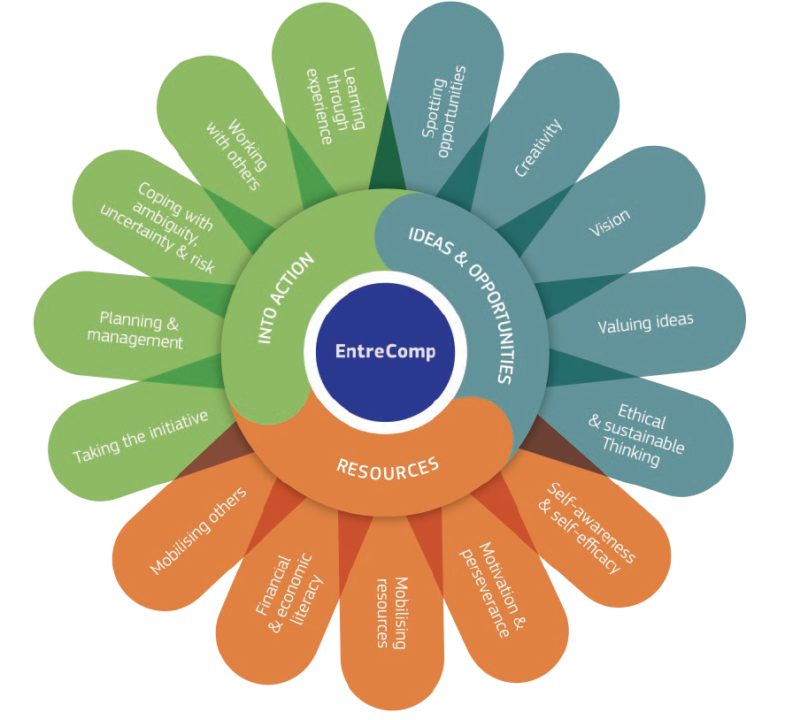
3.3 Coping with uncertainty, ambiguity and risk
3.3.A Introduction and basics
This project has been funded with support from the European Commission. This document and its contents reflect the views only of the authors, and the Commission cannot be held responsible for any use which may be made of the information contained therein​
Legal description – Creative Commons licensing: The materials published on the EntreComp project website are classified as Open Educational Resources' (OER) and can be freely (without permission of their creators): downloaded, used, reused, copied, adapted, and shared by users, with information about the source of their origin.

Slide 2
What do we mean with risk?
Uncertainty, ambiguity and risk in business are the basic barriers or challanges to the development of any enterprise or business. The ability to deal with it is crucial for business development, increasing profits and in many cases also survival in the market.
At the stage of establishing the enterprise, a SWOT analysis (strengths and weaknesses, opportunities and threats) is created. Once the business is up and running, dealing with incompetence, ambiguity and risk is a key part of management.
This project has been funded with support from the European Commission. This document and its contents reflect the views only of the authors, and the Commission cannot be held responsible for any use which may be made of the information contained therein​
Legal description – Creative Commons licensing: The materials published on the EntreComp project website are classified as Open Educational Resources' (OER) and can be freely (without permission of their creators): downloaded, used, reused, copied, adapted, and shared by users, with information about the source of their origin.

Slide 3
Seeking definitions
Uuncertainty (in Business) a situation, in which the probability distribution is unknown (i.e. something that can be understood in more than one way or can have more than one outcome)
Risk refers to the probability or threat of loss, liability, injury, damage, or any other negative occurrence resulting from external or internal vulnerabilities, and that may be prevented or avoided through preventive action
This project has been funded with support from the European Commission. This document and its contents reflect the views only of the authors, and the Commission cannot be held responsible for any use which may be made of the information contained therein​
Legal description – Creative Commons licensing: The materials published on the EntreComp project website are classified as Open Educational Resources' (OER) and can be freely (without permission of their creators): downloaded, used, reused, copied, adapted, and shared by users, with information about the source of their origin.

Slide 4
To resume:
In order to obtain the full picture of uncertainty and ambiguity, we can make a comparison with understanding certainty:
Cerainity | Risk | Uncertanity
An event that must happen | Probable event | An unpredictable, almost impossible event
Full and complete information | Incomplete information | Lack of information
Specific, known consequences | A known set of possible consequences | Unknown consequences of a given decision
Very unlikely to be consequences of taking decision | You can analyze the likelihood of making a wrong decision | Inability to analyze the probability of making a bad / good decision
Source: own study
This project has been funded with support from the European Commission. This document and its contents reflect the views only of the authors, and the Commission cannot be held responsible for any use which may be made of the information contained therein​
Legal description – Creative Commons licensing: The materials published on the EntreComp project website are classified as Open Educational Resources' (OER) and can be freely (without permission of their creators): downloaded, used, reused, copied, adapted, and shared by users, with information about the source of their origin.

Slide 5
Obstacles in doing business pt.1
Barriers in doing business
Barriers to entry is an economics and business term describing factors that can prevent or impede newcomers into a market or industry sector, and so limit competition. These can include high start-up costs, regulatory hurdles, or other obstacles that prevent new competitors from easily entering a business sector
Labo cost
Regulations
Access to financing sources
Tax system
Law
Administrative procedures
Gray market
Source: own study
This project has been funded with support from the European Commission. This document and its contents reflect the views only of the authors, and the Commission cannot be held responsible for any use which may be made of the information contained therein​
Legal description – Creative Commons licensing: The materials published on the EntreComp project website are classified as Open Educational Resources' (OER) and can be freely (without permission of their creators): downloaded, used, reused, copied, adapted, and shared by users, with information about the source of their origin.

Slide 6
Obstacles in doing business pt.2
 | Uncertainty | Ambiguity | Risk
Law / regulations | What regulations will apply when they change? | Will the legal regulations be clear, clear, easy to interpret? | Are the legal provisions unambiguous in their interpretation
Administrative procedures | Bribery, extension of cases, length of decisions, obtaining permits | Unclear provisions, freedom in interpretation | Change in law, unfavorable legal solutions, unstable law
Tax system | What will be the changes in the tax system, will the taxes change, will there be new ones introduced? | How to interpret the provisions of tax regulations | Tax changes, does it interpret tax regulations correctly?
Accsess to financing sources | Will there be access to financing? | Wheter the available funds are intended for us | Will the cost of loans or advances be higher?
Access to workers | Will there be permanent access to employees? | Will the employees want to be hired? | Can we lose employees, can they leave their jobs to compete?
Source: own study
This project has been funded with support from the European Commission. This document and its contents reflect the views only of the authors, and the Commission cannot be held responsible for any use which may be made of the information contained therein​
Legal description – Creative Commons licensing: The materials published on the EntreComp project website are classified as Open Educational Resources' (OER) and can be freely (without permission of their creators): downloaded, used, reused, copied, adapted, and shared by users, with information about the source of their origin.

Slide 7
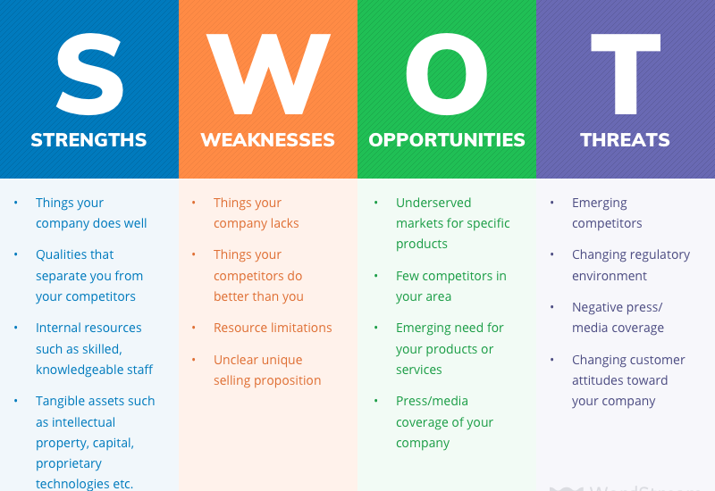
Obstacles in doing business pt.3
A SWOT Analysis perspective
SWOT stands for Strengths, Weaknesses, Opportunities, and Threats. It is a technique for assessing these four aspects of your business.
Conducting a SWOT analysis is a powerful way to evaluate your company or project.
The primary objective of a SWOT analysis is to help organizations develop a full awareness of all the factors involved in making a business decision.
Source: https://www.wordstream.com/blog/ws/2017/12/20/swot-analysis
This project has been funded with support from the European Commission. This document and its contents reflect the views only of the authors, and the Commission cannot be held responsible for any use which may be made of the information contained therein​
Legal description – Creative Commons licensing: The materials published on the EntreComp project website are classified as Open Educational Resources' (OER) and can be freely (without permission of their creators): downloaded, used, reused, copied, adapted, and shared by users, with information about the source of their origin.

Slide 8
3.3 Coping with uncertainty, ambiguity and risk
3.3.B The decision-making process
This project has been funded with support from the European Commission. This document and its contents reflect the views only of the authors, and the Commission cannot be held responsible for any use which may be made of the information contained therein​
Legal description – Creative Commons licensing: The materials published on the EntreComp project website are classified as Open Educational Resources' (OER) and can be freely (without permission of their creators): downloaded, used, reused, copied, adapted, and shared by users, with information about the source of their origin.

Slide 9
Effective decision making
Decision making is a vital component of small business success.
Decisions based on a foundation of knowledge and sound reasoning can lead the company into long-term prosperity; conversely, decisions made on the basis of flawed logic, emotionalism, or incomplete information can quickly put a small business out of commission.
This project has been funded with support from the European Commission. This document and its contents reflect the views only of the authors, and the Commission cannot be held responsible for any use which may be made of the information contained therein​
Legal description – Creative Commons licensing: The materials published on the EntreComp project website are classified as Open Educational Resources' (OER) and can be freely (without permission of their creators): downloaded, used, reused, copied, adapted, and shared by users, with information about the source of their origin.

Slide 10
7 Characteristics of a Good Decision
An appropriate decision frame
Clear values to adhere to and objectives you are trying to accomplish
Creative alternatives to choose from
Good information
Clear tradeoffs and sound reasoning
Choice alignment with values and objectives
Committed implementation
This project has been funded with support from the European Commission. This document and its contents reflect the views only of the authors, and the Commission cannot be held responsible for any use which may be made of the information contained therein​
Legal description – Creative Commons licensing: The materials published on the EntreComp project website are classified as Open Educational Resources' (OER) and can be freely (without permission of their creators): downloaded, used, reused, copied, adapted, and shared by users, with information about the source of their origin.

Slide 11
7 Ways to deal with uncertainty
Replace expectations with plans
Prepare for different possibilities
Become a feeling observer
Get confident about your coping and adapting skills
Utilize stress reduction techniques pre-emptively
Focus on what you can control
Practice mindfulness
According to Lori Deschene
This project has been funded with support from the European Commission. This document and its contents reflect the views only of the authors, and the Commission cannot be held responsible for any use which may be made of the information contained therein​
Legal description – Creative Commons licensing: The materials published on the EntreComp project website are classified as Open Educational Resources' (OER) and can be freely (without permission of their creators): downloaded, used, reused, copied, adapted, and shared by users, with information about the source of their origin.

Slide 12
Moreover…
Uncertainty is the only certainty there is, and knowing how to live with insecurity is the only security
John Allen Paulos
This project has been funded with support from the European Commission. This document and its contents reflect the views only of the authors, and the Commission cannot be held responsible for any use which may be made of the information contained therein​
Legal description – Creative Commons licensing: The materials published on the EntreComp project website are classified as Open Educational Resources' (OER) and can be freely (without permission of their creators): downloaded, used, reused, copied, adapted, and shared by users, with information about the source of their origin.

Slide 13
The words of the experts:
Below are three examples of authors who point out mistakes made when making decisions. On this basis, try to compile your list of mistakes made when making decisions
John Rampton
Sunk-cost fallacy
Warren Buffett and Charlie Munger
Perfectionism
Narrow framing
Emotionally driven decisions
Ego depletion
Halo effect
Making no decision can also be a mistake
Believing that collective decisions are better
Kicking a decision into the long grass
Overanalyzing and not listening to gut feeling
Making decisions without using checklists
Miguel Angel Ariño
Holding out for the perfect decision
Failing to face reality
Falling for self-deceptions
Going with the flow
Rushing and risking too much
Relying too heavily on intuition
Being married to our own ideas
Paying little heed to consequences
Overvaluing consensus
Not following through
Source: own study
This project has been funded with support from the European Commission. This document and its contents reflect the views only of the authors, and the Commission cannot be held responsible for any use which may be made of the information contained therein​
Legal description – Creative Commons licensing: The materials published on the EntreComp project website are classified as Open Educational Resources' (OER) and can be freely (without permission of their creators): downloaded, used, reused, copied, adapted, and shared by users, with information about the source of their origin.

Slide 14
The power of trust
Trust is the foundation and stimulus for every activity in the organization, it gives a sense of security and allows you to quickly react to changes in the environment.
There are eight Pillars of Trust (according to Business strategist David Horsager):
Clarity – People trust the clear and mistrust the ambiguous
Compassion – People put faith in those who care beyond themselves
Character – People notice those who do what is right over what is easy
Competency – People have confidence in those who stay fresh, relevant, and capable
Commitment – People believe in those who stand through adversity
Connection – People want to follow, buy from, and be around friends
Contribution – People immediately respond to results
Consistency – People love to see the little things done consistently
This project has been funded with support from the European Commission. This document and its contents reflect the views only of the authors, and the Commission cannot be held responsible for any use which may be made of the information contained therein​
Legal description – Creative Commons licensing: The materials published on the EntreComp project website are classified as Open Educational Resources' (OER) and can be freely (without permission of their creators): downloaded, used, reused, copied, adapted, and shared by users, with information about the source of their origin.

Slide 15
How uncertainty works…
At TEDxCanberra 2012, Nobel Prize for Physics recipient, Professor Brian Schmidt, provides a live, engaging and practical demonstration of just how uncertainty works in the real world (click the image for the video)
This project has been funded with support from the European Commission. This document and its contents reflect the views only of the authors, and the Commission cannot be held responsible for any use which may be made of the information contained therein​
Legal description – Creative Commons licensing: The materials published on the EntreComp project website are classified as Open Educational Resources' (OER) and can be freely (without permission of their creators): downloaded, used, reused, copied, adapted, and shared by users, with information about the source of their origin.

Slide 16
3.3 Coping with uncertainty, ambiguity and risk
3.3.C Risk in Business
This project has been funded with support from the European Commission. This document and its contents reflect the views only of the authors, and the Commission cannot be held responsible for any use which may be made of the information contained therein​
Legal description – Creative Commons licensing: The materials published on the EntreComp project website are classified as Open Educational Resources' (OER) and can be freely (without permission of their creators): downloaded, used, reused, copied, adapted, and shared by users, with information about the source of their origin.

Slide 17
Internal VS External risk
Business risks refers to the possibility of a commercial business making inadequate profits (or even losses) due to uncertainties.
Business risks can arise due to the influence by two major risks: internal risks (risks arising from the events taking place within the organization) and external risks (risks arising from the events taking place outside the organization).
This project has been funded with support from the European Commission. This document and its contents reflect the views only of the authors, and the Commission cannot be held responsible for any use which may be made of the information contained therein​
Legal description – Creative Commons licensing: The materials published on the EntreComp project website are classified as Open Educational Resources' (OER) and can be freely (without permission of their creators): downloaded, used, reused, copied, adapted, and shared by users, with information about the source of their origin.

Slide 18
Internal VS External risk: examples
Internal risks
human factors (talent management, strikes)
External risks
economic factors (market risks, pricing pressure)
technological factors (emerging technologies)
physical factors (failure of machines, fire or theft)
operational factors (access to credit, cost cutting, advertisement)
natural factors (floods, earthquakes)
political factors (compliance demands and regulations imposed by governments)
This project has been funded with support from the European Commission. This document and its contents reflect the views only of the authors, and the Commission cannot be held responsible for any use which may be made of the information contained therein​
Legal description – Creative Commons licensing: The materials published on the EntreComp project website are classified as Open Educational Resources' (OER) and can be freely (without permission of their creators): downloaded, used, reused, copied, adapted, and shared by users, with information about the source of their origin.

Slide 19
What is Risk Management?
Risk management helps you make better business decisions. It involves reducing the things that could have a negative effect on your business.
For example, the reducing the risk of injury by through safety procedures.
This project has been funded with support from the European Commission. This document and its contents reflect the views only of the authors, and the Commission cannot be held responsible for any use which may be made of the information contained therein​
Legal description – Creative Commons licensing: The materials published on the EntreComp project website are classified as Open Educational Resources' (OER) and can be freely (without permission of their creators): downloaded, used, reused, copied, adapted, and shared by users, with information about the source of their origin.

Slide 20
How you can manage risk?
Before you decide what to do, you’ll need to work out what your risks are and which ones are most urgent
Identify – work out what risks your business could face
Analyse – find the level of the risks and which ones are most urgent
Evaluate – compare the risk against set risk criteria to decide what to do
This project has been funded with support from the European Commission. This document and its contents reflect the views only of the authors, and the Commission cannot be held responsible for any use which may be made of the information contained therein​
Legal description – Creative Commons licensing: The materials published on the EntreComp project website are classified as Open Educational Resources' (OER) and can be freely (without permission of their creators): downloaded, used, reused, copied, adapted, and shared by users, with information about the source of their origin.

Slide 21
How the best do it...
Jeff Bezos. If you choose to only do things that you know will work, you will leave many options on the table
Richard Branson. You can be careful and try to avoid risks, but you can't protect yourself all the time
Walt Disney. In my opinion, courage is the main quality of leadership. Usually it involves risk taking, especially in new ventures
Mark Zuckerberg. The biggest risk is not taking any risks. In a rapidly changing world, the strategy that guarantees failure is not taking risks
Henry Ford. No one can really guarantee the future. The best we can do is increase the chances, calculate the risks involved, assess our ability to deal with them, and execute our plans safely
Source: own study
This project has been funded with support from the European Commission. This document and its contents reflect the views only of the authors, and the Commission cannot be held responsible for any use which may be made of the information contained therein​
Legal description – Creative Commons licensing: The materials published on the EntreComp project website are classified as Open Educational Resources' (OER) and can be freely (without permission of their creators): downloaded, used, reused, copied, adapted, and shared by users, with information about the source of their origin.

Slide 22
Ways of dealing with uncertainty…
In short:
Knowledge
Constantly raise your knowledge, work on yourself, read, be interested, try to make you an expert in your field,
Character traits and personality
Actions, decisions we make
Convictions
Develop your positive character traits. It allows us to establish good relationships with others and help us function well in life, e.g. assertiveness, accuracy, communication skills, loyalty, duty, diligence, etc.
The actions we take, the next steps that lead us to a decision
Beliefs, personality; our intuition, self-confidence, our beliefs, non-mental cognition, intuition,
Source: own study
This project has been funded with support from the European Commission. This document and its contents reflect the views only of the authors, and the Commission cannot be held responsible for any use which may be made of the information contained therein​
Legal description – Creative Commons licensing: The materials published on the EntreComp project website are classified as Open Educational Resources' (OER) and can be freely (without permission of their creators): downloaded, used, reused, copied, adapted, and shared by users, with information about the source of their origin.

Slide 23
…and the implication for business:
In short:
uncertainty
A situation, in which the probability distribution is unknown. Uncertain – ‘Something that is not exactly known or decided’.
ambiguity
Something that can be understood in more than one way or can have more than one outcome’.
risk
Refers to the probability or threat of loss, liability, injury, damage, or any other negative occurrence resulting from external or internal vulnerabilities, and that may be prevented or avoided through preventive action
Source: own study
This project has been funded with support from the European Commission. This document and its contents reflect the views only of the authors, and the Commission cannot be held responsible for any use which may be made of the information contained therein​
Legal description – Creative Commons licensing: The materials published on the EntreComp project website are classified as Open Educational Resources' (OER) and can be freely (without permission of their creators): downloaded, used, reused, copied, adapted, and shared by users, with information about the source of their origin.

Slide 24
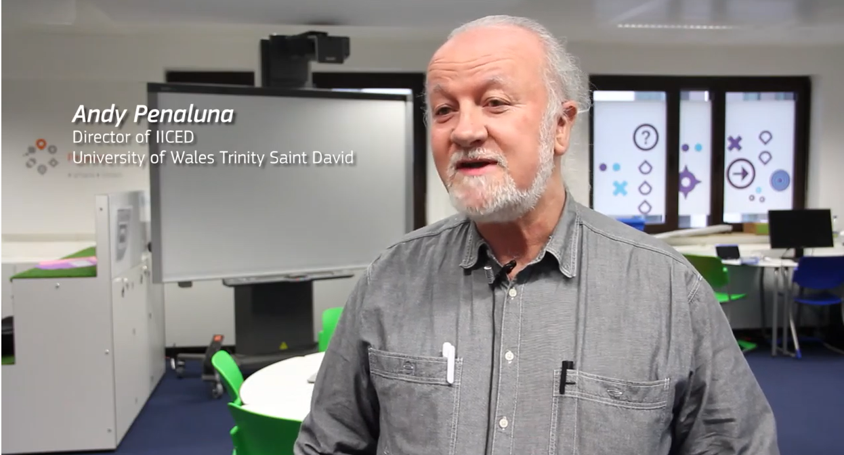
Suggestions for self-study
In this video, Andy Penaluna, Director of the International Institute for Creative Entrepreneurial Development (http://www.uwtsd.ac.uk/iiced) at the University of Wales Trinity Saint David, explains that students can be exposed to uncertain, ambiguous activities where things change, deadlines shifts and there are no clear instructions on what shall be done next. Being exposed to such situations allows them to develop strategies to cope and learn to flexibly adapt to changing environments.
This project has been funded with support from the European Commission. This document and its contents reflect the views only of the authors, and the Commission cannot be held responsible for any use which may be made of the information contained therein​
Legal description – Creative Commons licensing: The materials published on the EntreComp project website are classified as Open Educational Resources' (OER) and can be freely (without permission of their creators): downloaded, used, reused, copied, adapted, and shared by users, with information about the source of their origin.

Slide 25
To recap:
Every business is associated with uncertainty, ambiguity & risk
Be guided by your reason, experience, and intuition in making binding decisions
You will never avoid situations in which you will make important decisions
You can always consult someone, discuss the matter in the team, try to thoroughly investigate a given situation
Everyone makes mistakes and you can make them
This project has been funded with support from the European Commission. This document and its contents reflect the views only of the authors, and the Commission cannot be held responsible for any use which may be made of the information contained therein​
Legal description – Creative Commons licensing: The materials published on the EntreComp project website are classified as Open Educational Resources' (OER) and can be freely (without permission of their creators): downloaded, used, reused, copied, adapted, and shared by users, with information about the source of their origin.

Slide 26
To recap: Checklist for self-check
What are differences between uncertainty, ambiguity & risk in running businesses?
What is swot and what do we do by swot analyse?
What are the greatest difficulties in doing business?
Name at least one uncertainty, ambiguity & risk connected with Law / regulations in running business?
Please describe decision-making process
This project has been funded with support from the European Commission. This document and its contents reflect the views only of the authors, and the Commission cannot be held responsible for any use which may be made of the information contained therein​
Legal description – Creative Commons licensing: The materials published on the EntreComp project website are classified as Open Educational Resources' (OER) and can be freely (without permission of their creators): downloaded, used, reused, copied, adapted, and shared by users, with information about the source of their origin.

Slide 27
To recap: Checklist for self-check
Would you describe a trust as a way to deal with uncertainty
Will you name internal risks and external risks in business ?
Name the ways of dealing with uncertainty and ambiguity in business?
How you can manage risk in your business?
Why risk in business doesn’t always mean dangerous?
How can we deal with uncertainty, uncertainty and risk
This project has been funded with support from the European Commission. This document and its contents reflect the views only of the authors, and the Commission cannot be held responsible for any use which may be made of the information contained therein​
Legal description – Creative Commons licensing: The materials published on the EntreComp project website are classified as Open Educational Resources' (OER) and can be freely (without permission of their creators): downloaded, used, reused, copied, adapted, and shared by users, with information about the source of their origin.

